Slide 1

CS619
Final Viva Preparation CS403 FAVOURITE SUBJECT + PPT QUESTIONS
Haroon Nadir

Slide 2
CS403 FAVOURITE SUBJECT + PPT QUESTIONS
Let’s start with the first set of slides

Slide 3
Scope of the project
Project scope is the part of project planning that involves determining and documenting a list of specific project goals, deliverables, features, functions, tasks, deadlines, and ultimately costs. In other words, it is what needs to be achieved and the work that must be done to deliver a project

Slide 4
Functional Requirements
A functional requirement describes what a software system should do, Functional Requirements: specify the functionality of the system
Functional requirements are the activities that
a system must perform

Slide 5
Non-Functional Requirements
define system attributes such as security, reliability, performance, maintainability, scalability, and usability. They serve as constraints or restrictions on the design of the system across the different backlogs. They ensure the usability and effectiveness of the entire system

Slide 6
Use Case Diagram
A use case diagram at its simplest is a representation of a user's interaction with the system that shows the relationship between the user and the different use cases in which the user is involved.

Slide 7
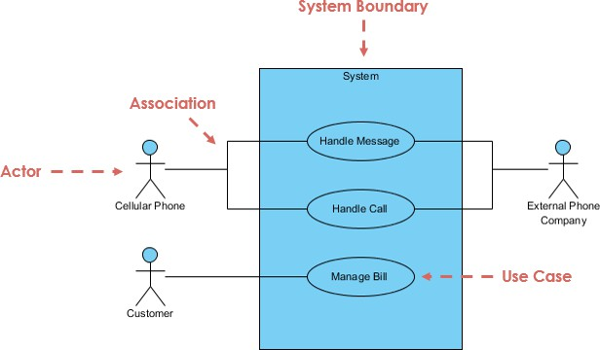
Use Case Diagram Example

Slide 8
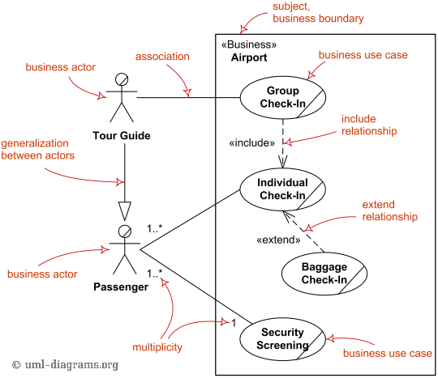
Use Case Diagram Relationships

Slide 9
Adopted Methodology
It is a method to use development of project. We have adopted the VU Process Model which is the combination of Waterfall methodology and Spiral methodology. VU Process Model will combine the benefits of Waterfall and Spiral methodologies.

Slide 10
The Waterfall Model
The waterfall model is a sequential design process, used in software development processes, in which progress is seen as flowing steadily downwards (like a waterfall) through the phases of Conception, Initiation, Analysis, Design, Construction, Testing, Production/Implementation and Maintenance

Slide 11
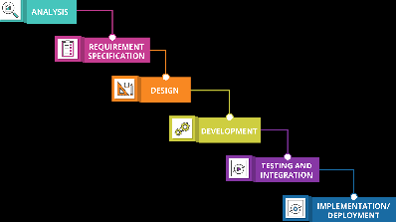
The Waterfall Model Diagram

Slide 12
Reasons for Choosing VU process Model
The main idea to choose is to get the benefits of both these models.
It is sequential model with backward repetition.
We want to achieve the linear nature of waterfall and iterative plus risk reduction nature of spiral model.

Slide 13
Reasons for Choosing VU process Model
Continuous
In vu process model we will be work in phases to complete the given project.
5. All the activities are performed in a sequence in VU Process Model.

Slide 14
Entity Relationship Diagram (ERD)
An entity-relationship diagram otherwise known as an ERD is a data modeling technique that creates an illustration of an information system's entities and the relationships between those entities

Slide 15
ER Diagrams Symbols & Notations
Rectangles: This Entity Relationship Diagram symbol represents entity types
Ellipses : Symbol represent attributes
Diamonds: This symbol represents relationship types
Lines: It links attributes to entity types and entity types with other relationship types

Slide 16
ER Diagrams Symbols & Notations
Primary key: attributes are underlined
Double Ellipses: Represent multi-valued attributes

Slide 17
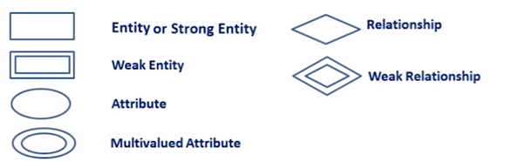
ER Diagrams Symbols & Notations

Slide 18
Components of the ER Diagram
This model is based on three basic concepts:
Entities
Attributes
Relationships

Slide 19
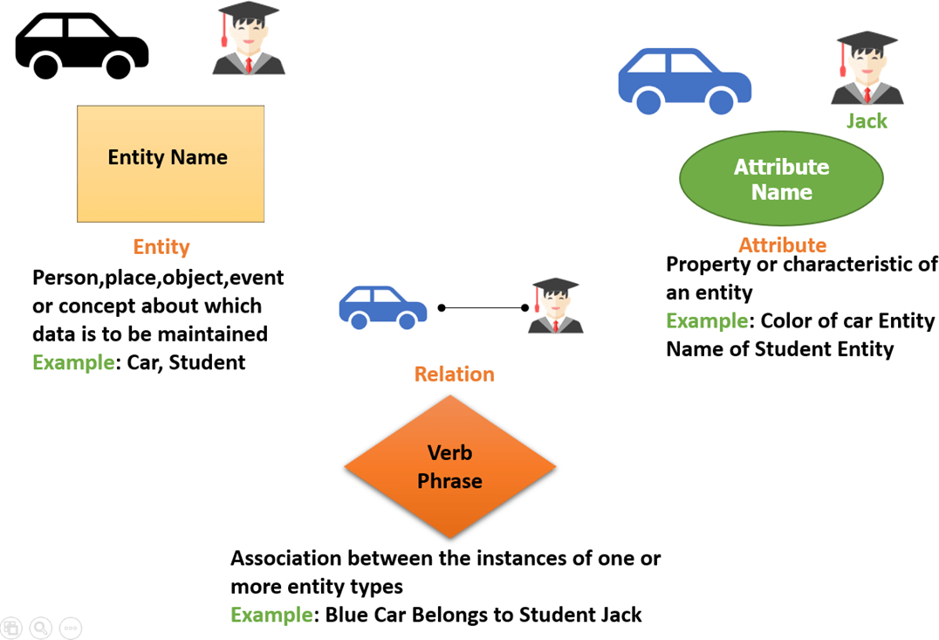
ER Diagram Examples

Slide 20
WHAT IS ENTITY?
An entity can be place, person, object, event or a concept, which stores data in the database. The characteristics of entities are must have an attribute, and a unique key. Every entity is made up of some 'attributes' which represent that entity

Slide 21
Examples of entities:
Person: Employee, Student, Patient
Place: Store, Building
Object: Machine, product, and Car
Event: Sale, Registration, Renewal
Concept: Account, Course

Slide 22
ENTITY TYPES
Strong Entity
Recursive Entity
Weak Entity

Slide 23
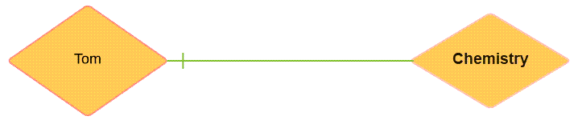
Relationship In ERD
Relationship is nothing but an association among two or more entities. E.g., Tom works in the Chemistry department.

Slide 24
Relationship In ERD example:
You are attending this lecture
I am giving the lecture
Just look entities, we can classify relationships according to relationship-types:
A student attends a lecture
A lecturer is giving a lecture.

Slide 25
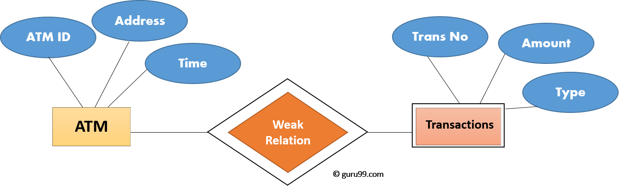
Weak Entities
A weak entity is a type of entity which doesn't have its key attribute. It can be identified uniquely by considering the primary key of another entity. For that, weak entity sets need to have participation.

Slide 26
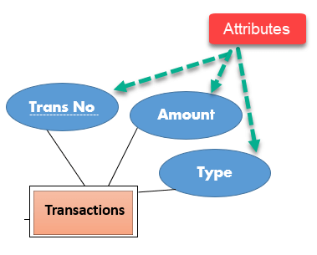
Attributes In ERD
It is a single-valued property of either an entity-type or a relationship-type.
For example, a lecture might have attributes: time, date, duration, place, etc.
An attribute in ER Diagram examples, is
represented by an Ellipse

Slide 27
Cardinality
Defines the numerical attributes of the relationship between two entities or entity sets.
Different types of cardinal relationships are:
One-to-One Relationships
One-to-Many Relationships
May to One Relationships
Many-to-Many Relationships

Slide 28
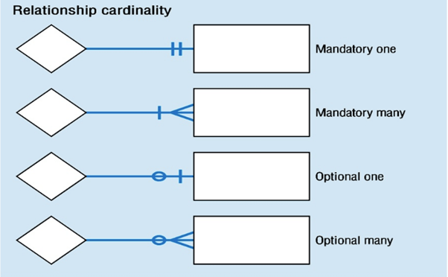
Cardinal Relationships

Slide 29
Modality In ERD
Components used in the creation of an ERD: Entity – A person, place or thing about which we want to collect and store multiple instances of data. Modality refers to the minimum number of times an instance in one entity can be associated with an instance in the related entity.
●

Slide 30

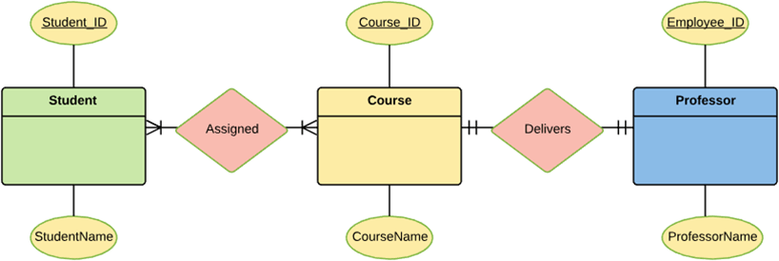
How to Create an ERD

Slide 31
What is Class Diagram
Class Diagram defines the types of objects in the system and the different types of relationships that exist among them. It gives a high-level view of an application. This modeling method can run with almost all Object-Oriented Methods. A class can refer to another class. A class can have its objects or may inherit from other classes

Slide 32
Benefits of Class Diagram
Class Diagram Illustrates data models for even very complex information systems
It helps for better understanding of general schematics of an application.
Allows drawing detailed charts which
highlights code required to be programmed
Helpful for developers and other stakeholders.

Slide 33
Essential elements of A UML class diagram
Essential elements of UML class diagram are:
Class Name
Attributes
Operations

Slide 34
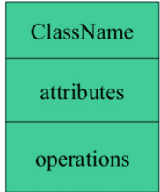
Class Name In Class Diagram
The name of the class is only needed in the graphical representation of the class. It appears in the topmost compartment.
same relationships, attributes, operations, semantics. The class is rendered as a rectangle, including its name, attributes, and operations in sperate compartments.
&

Slide 35
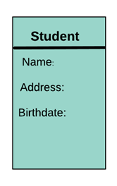
Attributes In Class Diagram
An attribute is named property of a class which describes the object being modeled. In the class diagram, this component is placed just below the name-compartment.

Slide 36
Relationships In Class Diagram
There are mainly three kinds of relationships in UML:
Dependencies
Generalizations
Associations

Slide 37

Dependency
A dependency means the relation between two or more classes in which a change in one may force changes in the other. However, it will always create a weaker relationship. Dependency indicates that one class depends on another.
E.g.

Slide 38
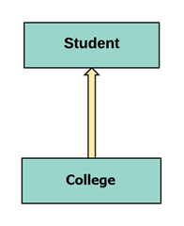
Generalization:
A generalization helps to connect a subclass to its superclass. A sub-class is inherited from its superclass. Generalization relationship can't be used to model interface implementation. Class diagram allows inheriting from multiple super classes.

Slide 39
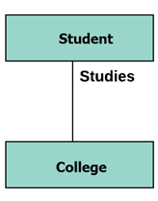
Association
This kind of relationship represents static relationships between classes A and B. For example; an employee works for an organization.

Slide 40
Some rules for Association
Association is mostly verb or a verb phrase or noun or noun phrase.
It should be named to indicate the role played by the class attached at the end of the association path.
Mandatory for reflexive associations

Slide 41
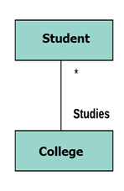
Multiplicity
A multiplicity is a factor associated with an attribute. It specifies how many instances of attributes are created when a class is initialized. If a multiplicity is not specified, by default one is considered as a default multiplicity.

Slide 42

Aggregation
Aggregation is a special type of association that models a whole- part relationship between aggregate and its parts.

Slide 43

Composition
The composition is a special type of aggregation which denotes strong ownership between two classes when one class is a part of another class.

Slide 44
Abstract Classes
This abstract class method can be used by any object such as a car, an animal, robot, etc. for changing the current position. It is efficient to use this abstract class method with an object because no implementation is provided for the given function. We can use it in any way for multiple objects

Slide 45
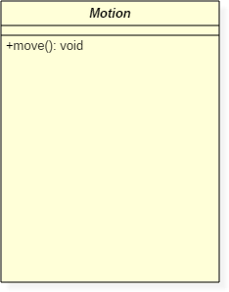
Abstract Class Notation

Slide 46
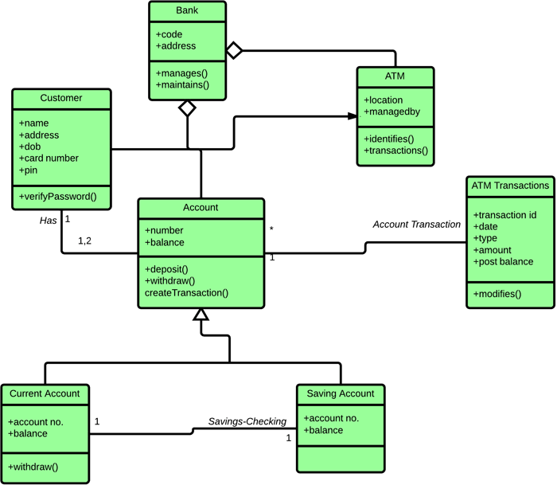
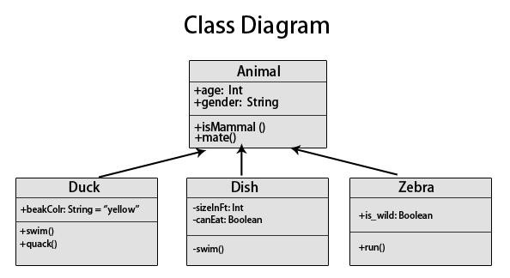
Example of UML Class Diagram

Slide 47
What is a Sequence Diagram
A SEQUENCE DIAGRAM simply depicts interaction between objects in a sequential order. The purpose of a sequence diagram in UML is to visualize the sequence of a message flow in the system. The sequence diagram shows the interaction between two lifelines as a time-ordered sequence of events

Slide 48
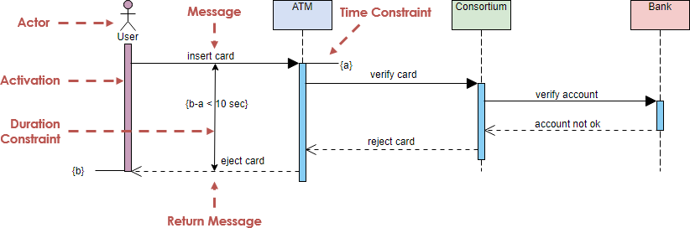
Sequence Diagram Example

Slide 49
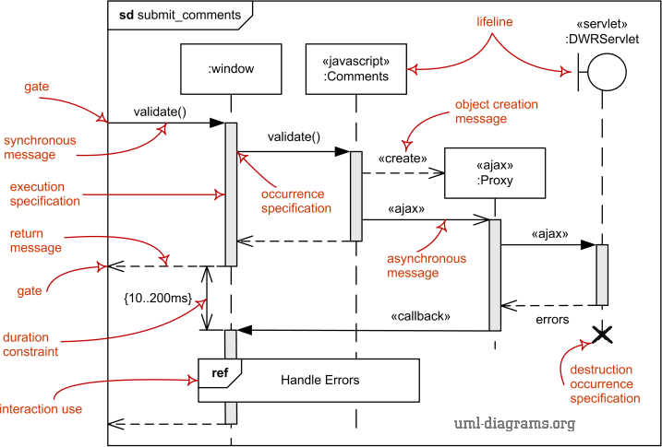
Sequence Diagram Example

Slide 50
Architecture Design Diagram
IEEE defines architectural design as 'the process of defining a collection of hardware and software components and their interfaces to establish the framework for the development of a computer system

Slide 51





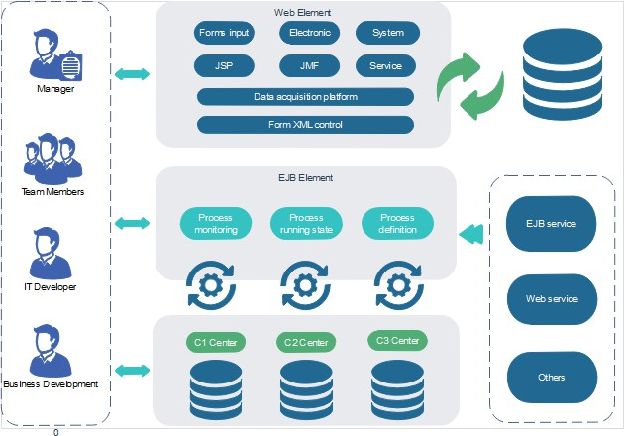
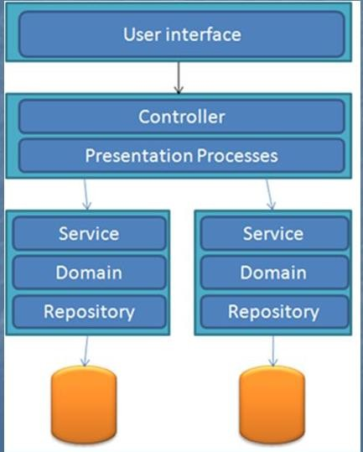
Architecture Design Diagram Example

Slide 52

CS403 Database Management System as Favorite Subject Viva Preparation

Slide 53
Database Management System
Database Management System is the set of programs or system which is used to create and maintain database.
Data: is the collection of raw, facts and figures like college admission form consists of data.
Database: is organized collection of related data.

Slide 54
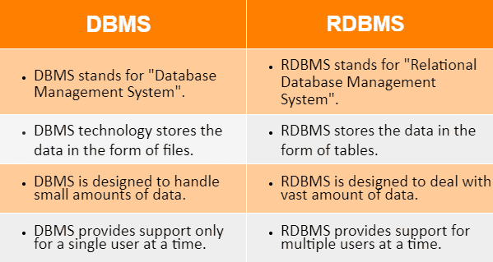
Difference between DBMS and RDBMS

Slide 55
Truncate, Delete and Drop
The SQL TRUNCATE TABLE command is used to delete complete data from an existing table.
The SQL DROP TABLE statement is used to remove a table definition and all the data, indexes, triggers, constraints and permission specifications for that table.

Slide 56
What is trigger
A trigger is a special type of stored procedure that automatically runs when an event occurs in the database server. DML triggers run when a user tries to modify data through a data manipulation language (DML) event. DML events are INSERT, UPDATE, or DELETE statements on a table or vie

Slide 57
What is Normalization
Normalization is a database
design technique that reduces data
redundancy and eliminates undesirable characteristics like Insertion, Update and Deletion Anomalies. Normalization rules divides larger tables into smaller tables and links them using relationships

Slide 58
Database Normal Forms
1NF (First Normal Form)
2NF (Second Normal Form)
3NF (Third Normal Form)
BCNF (Boyce-Codd Normal Form)
4NF (Fourth Normal Form)
5NF (Fifth Normal Form)
6NF (Sixth Normal Form)

Slide 59
Database Normal Forms
1NF (First Normal Form)
2NF (Second Normal Form)
3NF (Third Normal Form)
BCNF (Boyce-Codd Normal Form)
4NF (Fourth Normal Form)
5NF (Fifth Normal Form)
6NF (Sixth Normal Form)

Slide 60
Database Normalization With Examples
Database Normalization Example can be easily understood with the help of a case study. Assume, a video library maintains a database of movies rented out. Without any normalization in database, all information is stored in one table as shown below. Let's understand Normalization database with normalization example with solution:

Slide 61
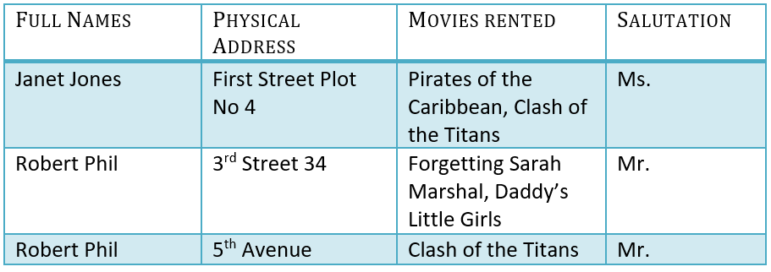
Database Normalization With Examples

Slide 62
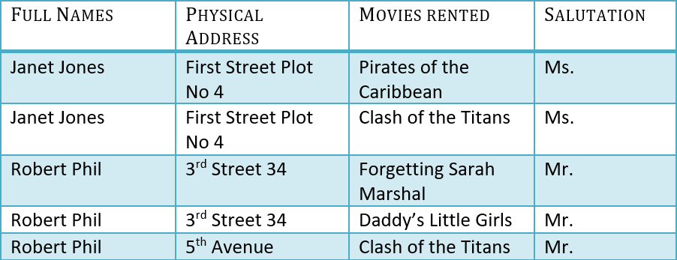
1NF (First Normal Form) Rules
Each table cell should contain a single value.
Each record needs to be unique.

Slide 63

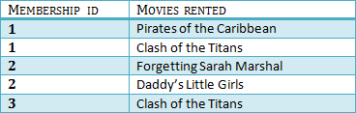
2NF (Second Normal Form) Rules
Rule 1- Be in 1NF
Rule 2- Single Column Primary Key that does
not functionally dependant on any subset of candidate key relation

Slide 64
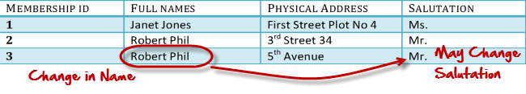
What are transitive functional dependencies?
A transitive functional dependency is when changing a non-key column, might cause any of the other non-key columns to change

Slide 65
3NF (Third Normal Form) Rules
Rule 1- Be in 2NF
Rule 2- Has no transitive functional dependencies

Slide 66

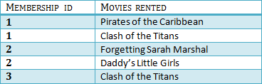

3NF Example

Slide 67
BCNF (Boyce-Codd Normal Form)
Even when a database is in 3rd Normal Form, still there would be anomalies resulted if it has more than one Candidate Key

Slide 68
4NF (Fourth Normal Form) Rules
If no database table instance contains two or more, independent and multivalued data describing the relevant entity, then it is in
4th Normal Form.

Slide 69
5NF (Fifth Normal Form) Rules
A table is in 5th Normal Form only if it is in 4NF and it cannot be decomposed into any number of smaller tables without loss of data.

Slide 70
6NF (Sixth Normal Form) Proposed
6th Normal Form is not standardized, yet however, it is being discussed by database experts for some time. Hopefully, we would have a clear & standardized definition for 6th Normal Form in the near future

Slide 71
What are Keys in DBMS
Summary. Eight types of key in DBMS are Super, Primary, Candidate, Alternate, Foreign, Compound, Composite, and Surrogate Key. A super key is a group of single or
multiple keys which identifies rows in a table. Primary Key never accept null values while a foreign key may accept multiple null values.

Slide 72
Example
Employee ID | FirstName | LastName
11 | Andrew | Johnson
22 | Tom | Wood
33 | Alex | Hale

Slide 73
Types of Keys in DBMS
Super Key
Primary Key
Candidate Key
Alternate Key
Foreign Key
Compound Key
Composite Key
Surrogate Key

Slide 74
What is the Super key
A super key is a group of single or multiple keys which identifies rows in a table
Example EmpSSN and EmpNum name are superkeys.
EmpSSN | EmpNum | Empname
9812345098 | AB05 | Shown
9876512345 | AB06 | Roslyn
199937890 | AB07 | James

Slide 75
What is a Primary Key
Primary key is a column or group of columns in a table that uniquely identify every row in that table.
Example
StudID is P.Key
Stud ID | Roll No | First Name | LastN ame | Email
1 | 11 | Tom | Price | abc@gmail. com
2 | 12 | Nick | Wright | xyz@gmail.c om
3 | 13 | Dana | Natan | mno@yahoo .com

Slide 76
What is Alternate Key
Alternate Key is a column or group of columns in a table that uniquely identify every row in that table.
Email A.key
StudID | Roll No | First Name | LastNam e | Email
1 | 11 | Tom | Price | abc@gm ail.com
2 | 12 | Nick | Wright | xyz@gm ail.com
3 | 13 | Dana | Natan | mno@ya hoo.com

Slide 77
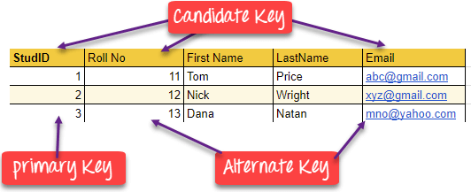
Candidate Key
Candidate Key is a set of attributes that uniquely identify tuples in a table. Candidate Key is a super key with no repeated attributes

Slide 78
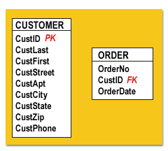
Foreign Key
Foreign Key is a column that creates a relationship between two tables. The purpose of Foreign keys is to maintain data integrity and allow navigation between two different instances of an entity.

Slide 79
Compound Key
Compound Key has two or more attributes that allow you to uniquely recognize a specific record. It is possible that each column may not be unique by itself within the database.
compound key of Order ID and Product ID
OrderNo | PorductID | Product Name | Quantity
B005 | JAP102459 | Mouse | 5
B005 | DKT321573 | USB | 10

Slide 80
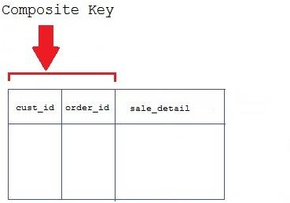
Composite Key
Composite Key is a combination of two or more columns that uniquely identify rows in a table. The combination of columns guarantees uniqueness, though individual uniqueness is not guaranteed

Slide 81
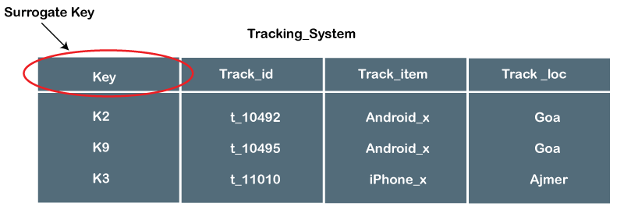
Surrogate Key
Surrogate Key An artificial key which aims to uniquely identify each record is called a surrogate key. These kind of key are unique because they are created when you don't have any natural primary key

Slide 82
Define table
Tables are database objects that contain all the data in a database. In tables, data is logically organized in a row-and-column format similar to a spreadsheet. Each row represents a unique record, and each column represents a field in the record

Slide 83
Define tuple
(1) In a relational database, a tuple is one record (one row). ... Typically separated by commas, the values may be parameters for a function call or a set of data values for
a database

Slide 84
What is SQL
SQL is the standard language for dealing with Relational Databases. SQL can be used to insert, search, update, and delete database records. SQL can do lots of other operations, including optimizing and maintenance of databases.

Slide 85
Types of SQL Statements
Data Definition Language (DDL)
Data Manipulation Language (DML)
Data Control Language (DCL)
Transaction Control Language (TCL)
Data Query Language (DQL

Slide 86
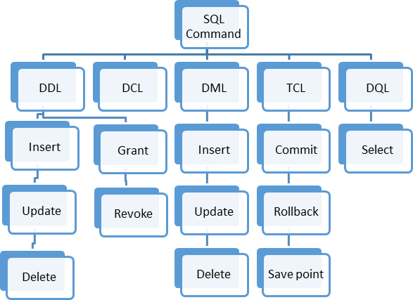
Types of SQL Statements

Slide 87
Data Definition Language
Data Definition Language helps you to define the database structure or schema. Let's learn about DDL commands with syntax.
Five types of DDL commands in SQL are

Slide 88
Data Manipulation Language
Data Manipulation Language (DML) allows you to modify the database instance by inserting, modifying, and deleting its data. It is responsible for performing all types of data modification in a database.
important DML commands in SQL
INSERT >UPDATE >DELETE

Slide 89
Data Control Language
DCL (Data Control Language) includes commands like GRANT and REVOKE, which are useful to give "rights & permissions." Other permission controls parameters of the database system.
Commands that come under DCL:
Grant
Revoke

Slide 90
Transaction control language
Transaction control language or TCL commands deal with the transaction within the database.

Slide 91
Data Query Language
Data Query Language (DQL) is used to fetch the data from the database. It uses only one command:

Slide 92
List of SQL Commands
CREATE - defines the database structure schema
INSERT - inserts data into the row of a table
UPDATE - updates data in a database
DELETE - removes one or more rows from a
table
SELECT - selects the attribute based on the condition described by the WHERE clause
DROP - removes tables and databases
92

Slide 93
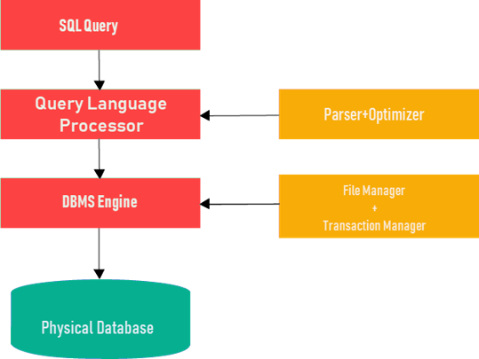
SQL Process

Slide 94
What is NoSQL
NoSQL is an upcoming category of Database Management Systems. Its main characteristic is its non-adherence to Relational Database Concepts. NoSQL means "Not only SQL". The concept of NoSQL databases grew with internet giants such as Google, Facebook, Amazon etc. who deal with gigantic volumes of data.

Slide 95
What is Functional Dependency
Functional Dependency (FD) is a constraint that determines the relation of one attribute to another attribute in a Database Management System (DBMS). Functional Dependency helps to maintain the quality of data in the database. It plays a vital role to find the difference between good and bad database design.

Slide 96
Types of Functional Dependencies
Multivalued Dependency
Trivial Functional Dependency
Non-Trivial Functional Dependency
Transitive Dependency

Slide 97
What is Relational Model
Relational Model (RM) represents the database as a collection of relations. A relation is nothing but a table of values. Every row in the table represents a collection of related data values. These rows in the table denote a real-world entity or relationship.

Slide 98
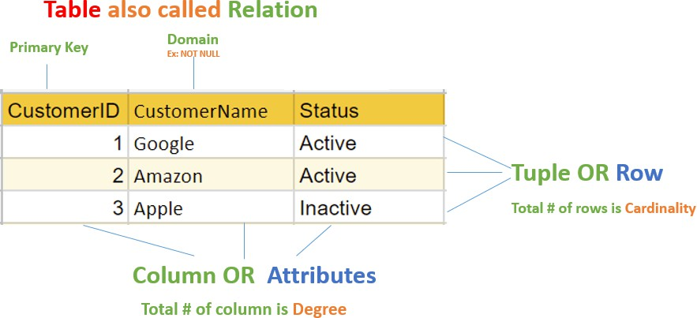
What is Relational Model

Slide 99
Subquery in DBMS
Answer: A Subquery is also known as a nested query i.e. a query written inside some query. When a Subquery is executed for each of the rows of the outer query then it is termed as a Correlated Subquery.

Slide 100
Three Level Architecture
The three schema architecture is also called ANSI/SPARC architecture or three-level architecture. This framework is used to describe the structure of a specific database system. The three schema architecture is also used to separate the user applications and physical database.

Slide 101
Three Level Architecture
The three schema architecture is also called ANSI/SPARC architecture or three-level architecture. This framework is used to describe the structure of a specific database system. The three schema architecture is also used to separate the user applications and physical database.

Slide 102
Three Level Architecture
Internal Level/Schema
Conceptual Schema/Level
External Schema/Level

Slide 103
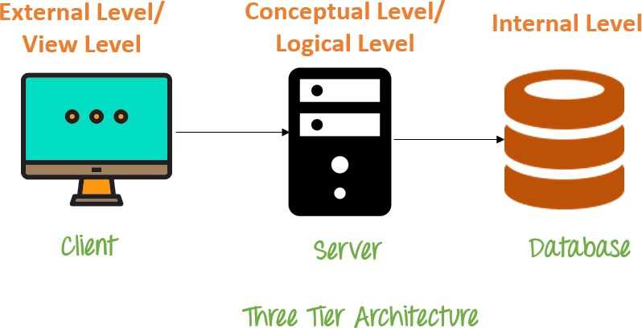
Three Level Architecture Diagram

Slide 104
Join In SQL
A Join is one of the SQL statements which is used to join the data or the rows from 2 or more tables on the basis of a common field/column among them.

Slide 105
Joins Types
Inner Join: This type of join is used to fetch the data among the tables which are common in both the tables.
Left Join: This returns all the rows from the table which is on the left side of the join but only the matching rows from the table which is on the right side of the join.

Slide 106
Joins Types
Right Join: This returns all the rows from the table which is on the right side of the join but only the matching rows from the table which is on the left side of the join.
Full Join: This returns the rows from all the tables on which the join condition has put and the rows which do not match hold null values

Slide 107


Thanks!
Any questions?
You can find me at:
@username
user@mail.me

